Slide 1
SMART Objectives EFL and ESL Classroom
Prepared by
Dr. Marine Milad

Slide 2
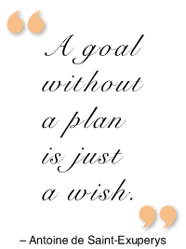
SMART Objectives
S = Specific
M = Measurable
A = Attainable
R = Realistic
T = Timed

Slide 3
About Objectives
Here is a list of specific, measurable verbs you can use when writing learning objectives for each level of the revised Bloom's Taxonomy:
Remember. Memorize, show, pick, spell, list, quote, recall, repeat, catalogue, cite, state, relate, record, name.
Understand. ...
Apply. ...
Analyze. ...
Evaluate. ...
Create.

Slide 4
Criteria of Assessment
It depends on the nature of the course (content-based or skill-based)
It depends the intended learning outcomes
It requires developing various level activities (Bloom’s Taxonomy)
Evaluation
Synthesis
Analysis
Application
Comprehension
Knowledge

Slide 5
Original Terms New Terms
Evaluation
Synthesis
Analysis
Application
Comprehension
Knowledge
Creating
Evaluating
Analyzing
Applying
Understanding
Remembering
(Based on Pohl, 2000, Learning to Think, Thinking to Learn, p. 8)

Slide 6
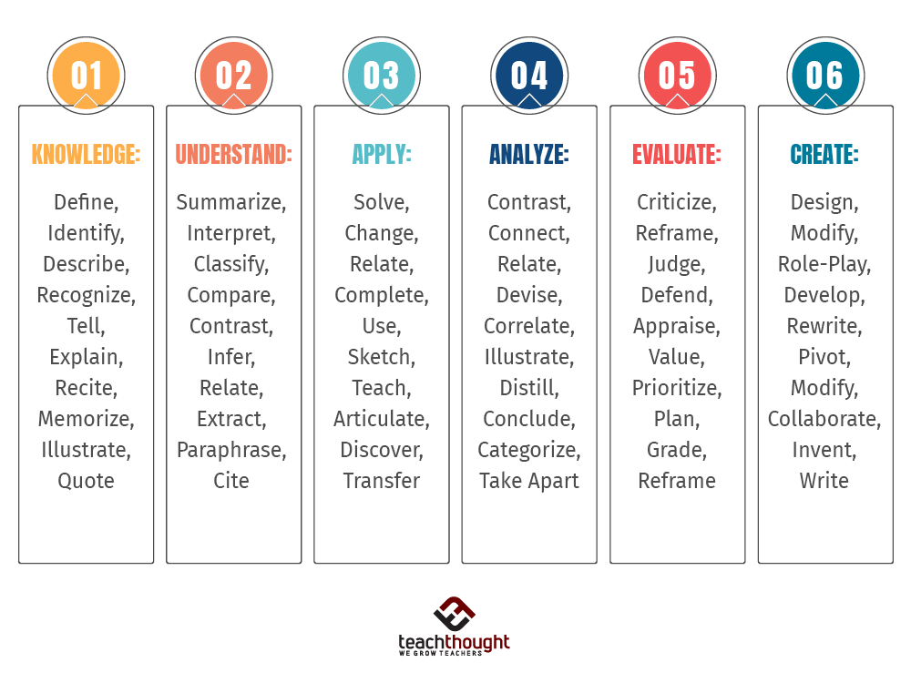
Bloom’s Taxonomy Verbs

Slide 7
Culminating learning outcome

Slide 8
What do you think? Is this a well written objective, or does it have problems?
In this lesson I will teach the students to pronounce /s/ and /z/ correctly.
Major problem with this objective ➔ specifies what the teacher will do. Objectives are more effective when they specify what the students will do.
Instructors often state objectives in terms of process or procedure while learning objectives refer to the end results of instruction.
A good learning objective states what a student will know or be able to do at the end of instruction.

Slide 9
Goal / Aim/ Objectives
Goal/Aim: What are we working toward today?
Describe the final result of the lesson in this format:
The students will be able to ___(do what?)________.
Example: The students will be able to ask and answer questions about their hobbies and interests
As a result of these activities, students will:
1. ……………………
2. ……………………
3. ……………………

Slide 10
Examples of well-written objectives
Students will use socially appropriate greeting expressions in role play situations.
Students will distinguish between English /s/ and /z/ sounds when they are used in sentences spoken naturally.
Students will differentiate simple present tense (e.g., "We eat.") from present progressive tense (e.g., "We are eating.") and use these tenses appropriately.

